Slide 1
Big Mountain Case Study
Steven Harpham

Slide 2
Problem Identification(1)
Big Mountain Resort came to us with some uncertainty about their pricing strategy.
Big Mountain Resort wishes to gain insight into investment/pricing strategy for their lift tickets.

Slide 3
Problem Identification(2)
Main Questions:
Does the recent addition of a chair lift allow for enough pricing power to cover the operating costs of that lift?
How is Big Mountain’s pricing positioned in the market, with respect to their features offered?

Slide 4
Recommendation and key findings
-The overall finding is that Big Mountain is undervaluing their current feature-set.
-They current weekend price is $81, the model predicts the resort can charge ~ $95.87.
-This is an 18% increase with no additional features added.
-We would recommend executives utilize the model before making any further investment decisions.
-It seems as though the additional chair lift will have been a poorly placed investment.

Slide 5
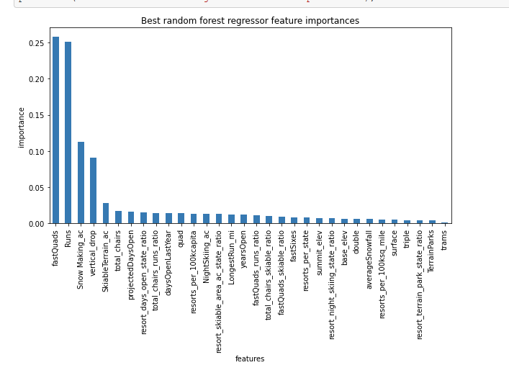
Modeling results and Analysis
The graphic to the right highlights the most important/powerful predictors in our model of price.
We will look in subsequent slides where Big Mountain Resort ranks on these features. .

Slide 6
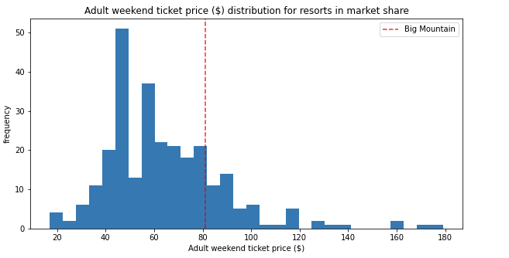
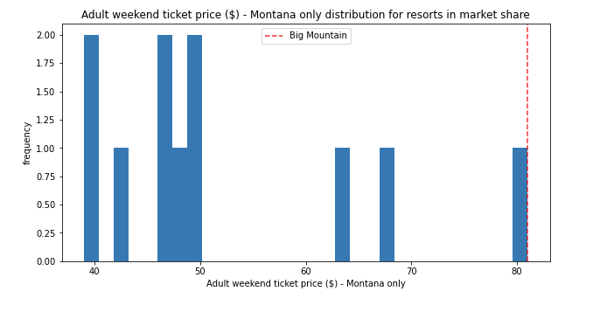
Modeling results and Analysis
Big Mountains price in the market is high, yes, but the feature set is offers gives it a competitive advantage over its customers.
To the right we see Big Mountains price, relative to the whole competitor ecosystem, and respectively, to the price of Montana resorts only.

Slide 7
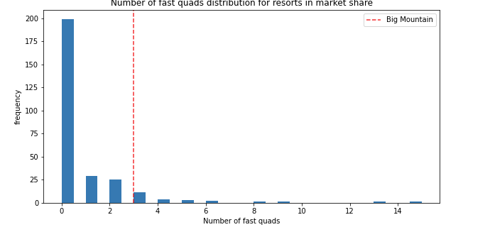
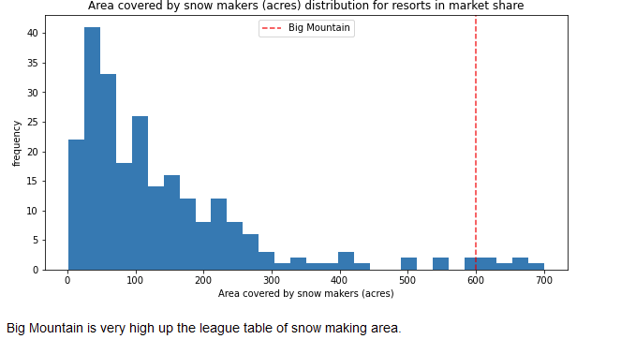
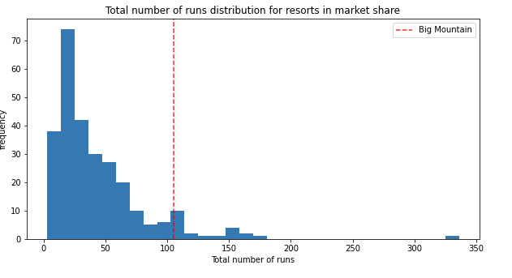
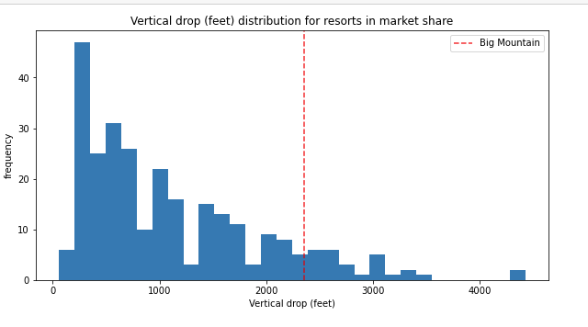
Modeling results and Analysis
Left to right, these graphics indicate Big Mountain’s position in the market, shown as a red line
These graphic represent the 4 most important/powerful predictors of price in our model.
We can see that Big Mountain is in the upper end of all these distributions.

Slide 8
Summary and Conclusion
It is clear that Big Mountain Resort is has a great market position with the feature set they currently have, which will allow them to charge a premium relative to their competitors.
Further investment into various features of the park should be passed through the data model we have created an implemented here, to predict if those investments will have an net positive return.

